Slide 1

Dr Shamila De Silva
Department of Medicine

Slide 2
Introduction
Diabetes is a chronic, lifelong disease
There is NO CURE for most
Patient compliance is important → early education
Care is based on self-management
Patient must understand risks of diabetes & potential benefits of good glycemic control
Misinformation from friends & other patients !!

Slide 3
Aims of Treatment
Freedom from symptoms & complications of hyperglycaemia
Freedom from hypoglycaemia
Minimal disruption of life style
Minimal psychological distress

Slide 4
Rationale of Treatment
Hyperglycaemia - main reason for developing microvascular complications
↓ of hyperglycaemia → mainstay of treatment
Macrovascular complications more dependent on non-glycaemic parameters
eg - BP, obesity, lipids

Slide 5
Management of DM
Diet
Lifestyle modification
Drugs
Insulin

Slide 6
Dietary Management - Objectives
1. Provide essential nutrients
2. Adopt to metabolic problems
eg – Type 1 → balance food, insulin and exercise
Type 2 → reduce weight
3. Prevent cardiovascular complications

Slide 7
Diet - General Recommendations
low in sugar (but not sugar-free)
high in starchy carbohydrate (low GI)
high in fibre
low in fat (sp saturated fat)
If overweight / obese → lose weight by reducing food intake & increasing physical activity

Slide 8
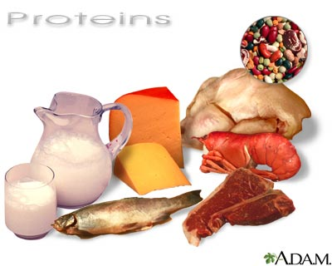
Protein
1 g/kg/day
10-20% of energy intake
Should not be less than 0.6g/kg/d

Slide 9
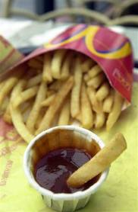
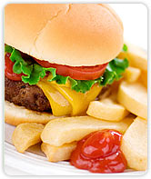
Fat
<35% of total energy intake (TEI)
Limit - fat/oil in cooking
fried foods
processed meats
high-fat snacks
Encourage - lower-fat dairy products
lean meat

Slide 10

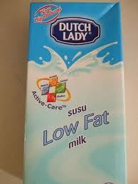
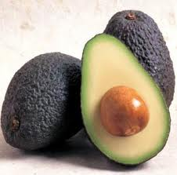
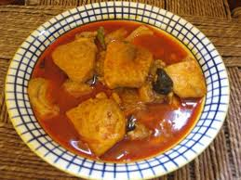
Fat
Eat fish 1-2/week (Fish oil supplements not recommended)
Cis-monounsaturated fat 10-20% of TEI (olive oil, avocado)
Dietary cholesterol 300 mg/d
Saturated and trans-unsaturated fat <10% of TEI
Polyunsaturated fat <10% of TEI

Slide 11
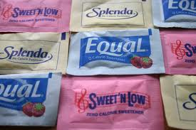
Carbohydrates
40-60% of TEI
Encourage - artificial sweeteners instead of sugar
Limit - fruit juices, confectionery, cake, biscuits
Sucrose up to 10% of TEI

Slide 12
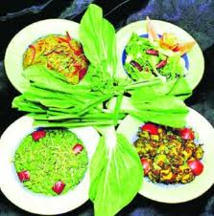

Carbohydrates
Fibre - no absolute quantity recommended
Soluble → beneficial in glycaemic and lipid metabolism
Insoluble → satiety & GI health
Foods with low glycaemic index - slower absorption
Cut refined sugars

Slide 13
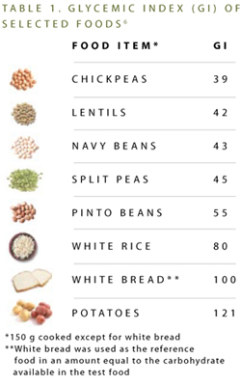

Slide 14
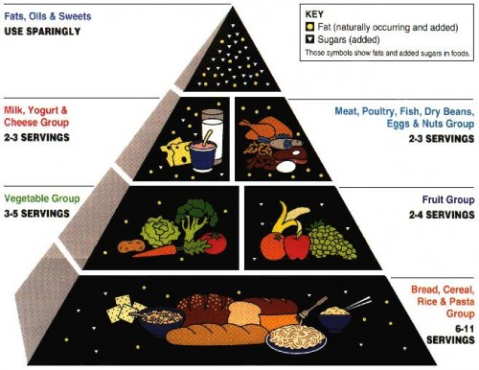
Healthy Diet Pyramid

Slide 15
Other
Vitamins and antioxidants
Best taken as fruit and vegetables
5 portions per day
No evidence for use of supplements
Alcohol
Not forbidden
Energy content
May cause delayed hypoglycaemia in those on Insulin
Salt
<6 g per day
Lower in hypertension

Slide 16
Prescribing a Diet
Repeated advice & encouragement
Diet history
Minimum interference with patients lifestyle
Diet sheets, Dietician
If on Insulin or oral agents - eat roughly the same amount of food (esp carbs) at roughly the same time each day
Regular blood glucose monitoring – DAFNE (Dose Adjustment For Normal Eating) regimen

Slide 17
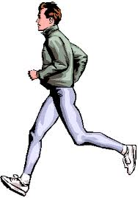

Exercise
Lowest long-term morbidity & mortality in patients with highest levels of CR fitness
Aerobic & resistance training improve insulin sensitivity and metabolic control in Type 1 & Type 2 DM
If on Insulin or Sulfonylureas - increased risk of hypoglycaemia for up to 6-12 hours following heavy exertion

Slide 18
Oral Hypoglycaemic Therapy
Diet + lifestyle changes = successful treatment of Type 2 DM
OHG if satisfactory metabolic control is not established within 4-6 weeks
Options - metformin
sulfonylurea
thiazolidinedione
meglitinides
DPP4 inhibitors

Slide 19
Biguanide (Metformin)
Best validated primary Rx for Type 2 DM
↓ gluconeogenesis - ↓ hepatic glucose output
↑ insulin sensitivity
Does NOT cause hypoglycaemia or weight gain
Can combine with sulfonylureas/ other OHGs

Slide 20
Biguanide (Metformin)
↓ microvascular complications
Only OHG giving cardiovascular protection
SEs - anorexia, epigastric discomfort, diarrhoea
less with slow-release preparations
Lactic acidosis if severe hepatic or renal disease - contraindicated
STOP when serum creatinine ≥ 150 μmol/L (1.9 mg/dl)

Slide 21
Sulfonylureas
Promote insulin secretion by beta cells
Good for short-term (1-3 years) glucose control
Effect wears off as beta-cell mass ↓
Promote weight gain – avoid in overweight / obese
Can cause hypoglycaemia – usually mild
Caution in liver disease
Renal impairment – give drugs primarily excreted by liver

Slide 22
Tolbutamide - lower maximal efficacy
short half-life - preferable in elderly
metabolized by liver - can use in renal impairment
Glibenclamide - long half-life
severe hypoglycaemia
do not use in the elderly

Slide 23
Glipizide & Glimepiride –
active metabolites
renal excretion - avoid in renal impairment
Gliclazide -
intermediate half-life
metabolized by liver - can use in renal impairment
more expensive
Chlorpropamide -
v. long half-life
renal excretion - avoid in renal impairment
cheap
fatal hypoglycaemia possible
not for elderly

Slide 24
Thiazolidinediones (Glitazones)
↓ insulin resistance (via peroxisome proliferator-activated receptor-gamma - PPAR-gamma)
Used alone or in combination
Pioglitazone
SEs - weight gain
fluid retention → heart failure
bladder CA

Slide 25
Dipeptidyl peptidase-4 (DPP4) Inhibitors
Enhance the Incretin effect
Linagliptin, Saxagliptin, Sitagliptin, Vildagliptin
Moderate blood glucose reduction
Weight neutral
More effective in early T2DM
Second line therapy
SE : uncommon, mainly nausea, rarely acute pancreatitis

Slide 26
Newer Therapies
Meglitinides
Sodium Glucose Transporter 2 Inhibitors (SGLT2)
GLP-1 agonists

Slide 27
Other Therapies
Acarbose - inhibits alpha-glucosidase enzymes → ↓ absorption of carbohydrate
SEs - abdominal discomfort, flatulence, diarrhoea
Orlistat - lipase inhibitor → ↓ absorption of fat
promotes weight loss
SE – steatorrhoea
Gastric banding and gastric bypass surgery –
in marked obesity unresponsive to 6 months' intensive dieting + exercise

Slide 28
Insulin Therapy – Short Acting
Beef, pig, biosynthetic human
Pre-meal injection in multiple dose regimens
Continuous intravenous infusion → labour, medical emergencies
Insulin pumps
absorbed slowly
peak 60-90 minutes after sc injection
action persist too long after meals → hypoglycaemia
Short-acting insulin analogues - more rapid absorption
insulin lispro, insulin aspart, insulin glulisine
no greater benefit

Slide 29
Insulin Therapy – Longer Acting
Intermediate Acting - NPH
isophane insulin
premixed with soluble insulin to form stable mixtures (30% soluble + 70% NPH)
Long Acting –
Insulin glargine, Insulin detemir
Little advantage over NPH

Slide 30
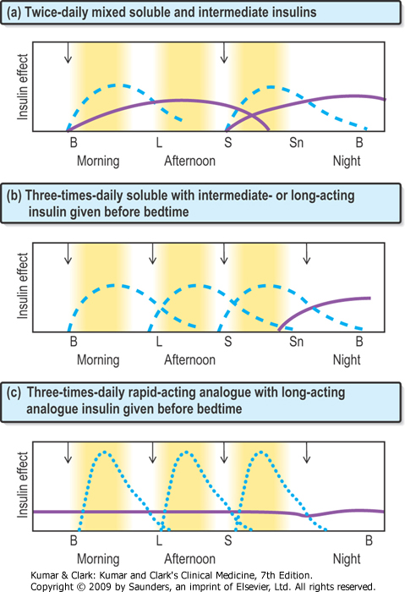

Slide 31
Other Measures
Blood pressure control –
angiotensin converting enzyme (ACE) inhibitor
angiotension II receptor (AIIR) antagonist
Statin
Aspirin – for some patients

Slide 32
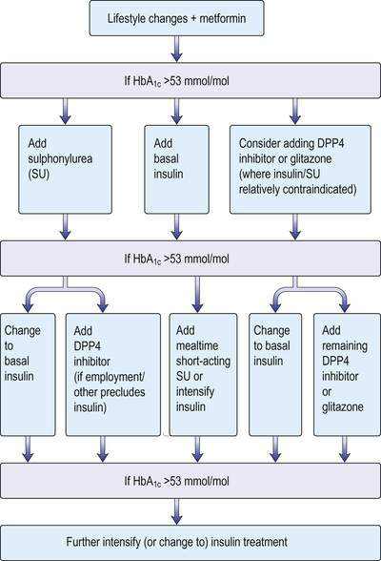

Slide 33
Monitoring DM Control
Urine Tests –
dipsticks
correlation with simultaneous blood glucose is poor
Home blood glucose tests –
FBS useful for tablet-treated Type 2 DM
RBS has limited value
Glycosylated Haemoglobin (HbA_{1C}) –
normal 4 - 6.2%
average blood glucose concentration over life span of Hb molecule

Slide 34
Targets
Parameter Ideal Reasonable
HbA1c <7% <8%
Blood pressure <130/80 <140/80
T. cholesterol <4.0 <5.0
LDL <2.0 <3.0
HDL >1.1 >0.8
Triglycerides <1.7 <2.0

Slide 35
Case
A 55 year old housewife with BMI 28.5 kg/m², has been diagnosed with type 2 Diabetes mellitus two days ago.
What are the principles of diet therapy for this patient?
What advice would you give regarding exercise?
What drug therapy is indicated?
How would you monitor her response to treatment, and adjust her drug therapy?

